Slide 1


Equipped to share your vision

Slide 2
Proverbs 29:18
Where there is no vision, the people perish.

Slide 3
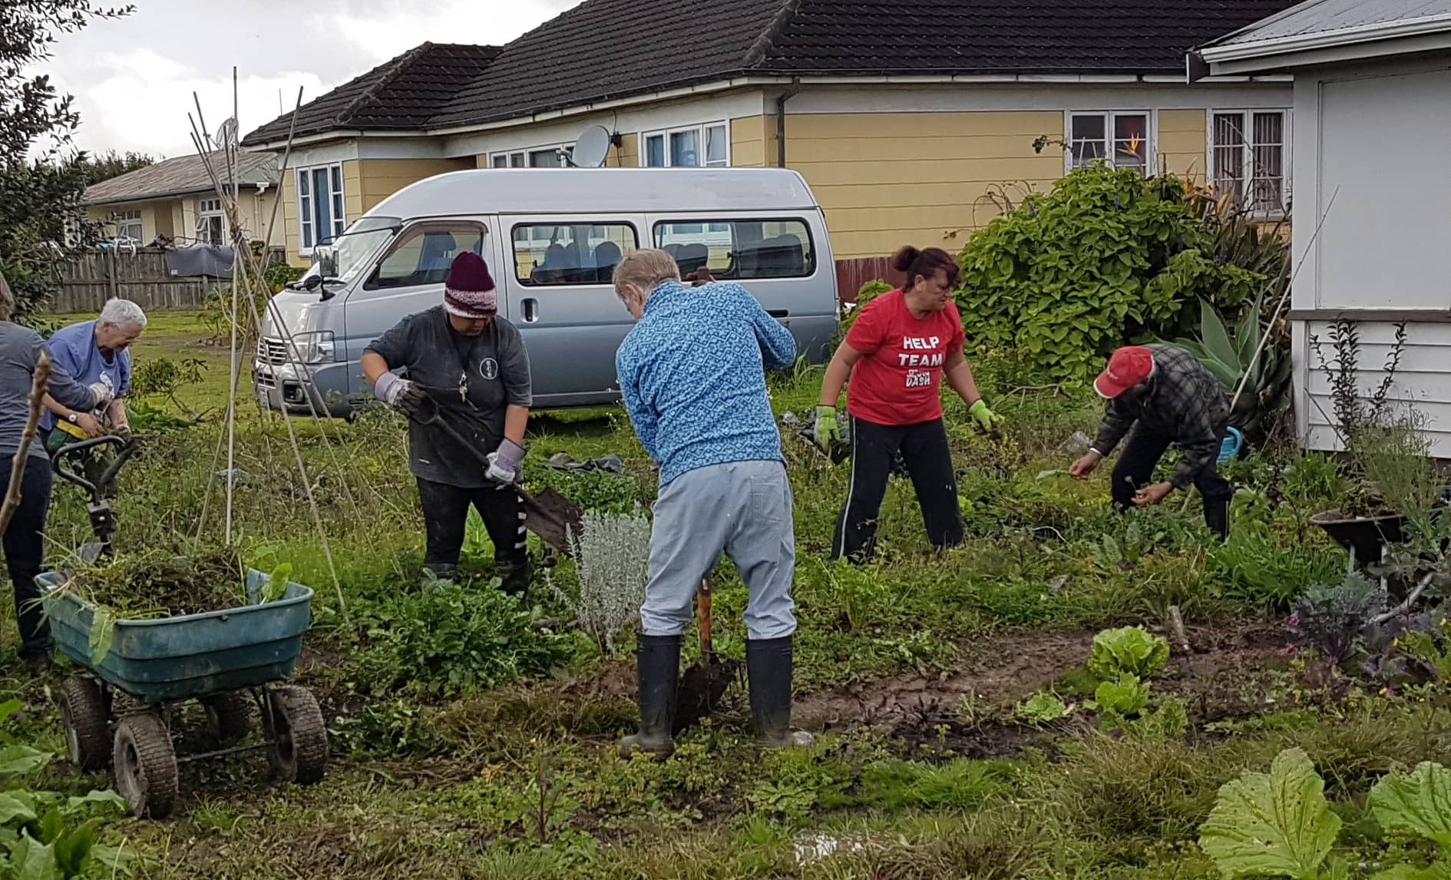
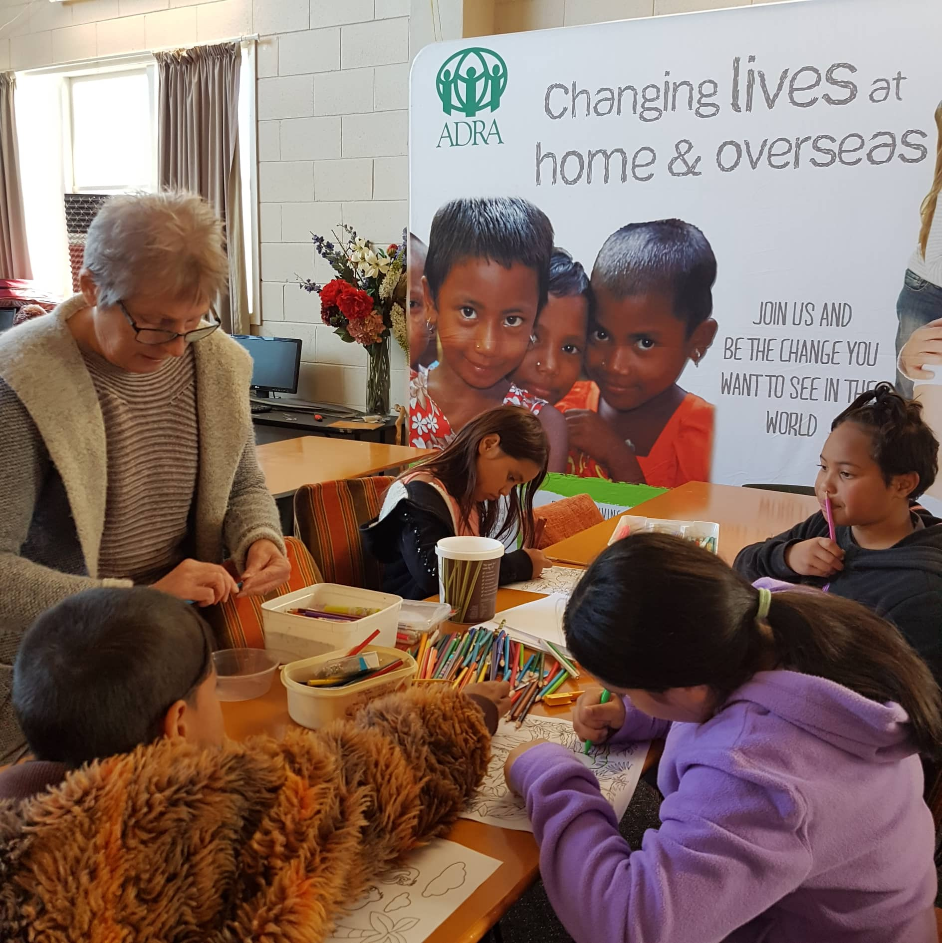
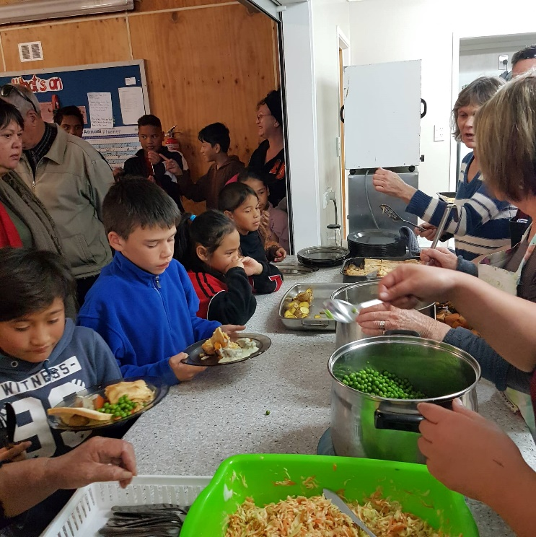
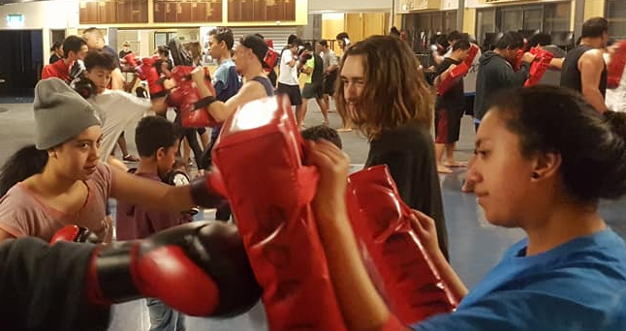
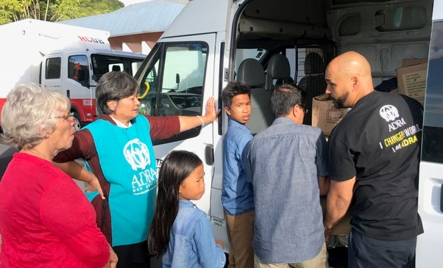
What is CTP?
Community Transformation Partnerships
Notes:
What is CTP?
- Who knows what CTP stands for? Community Transformation Partnerships

Slide 4
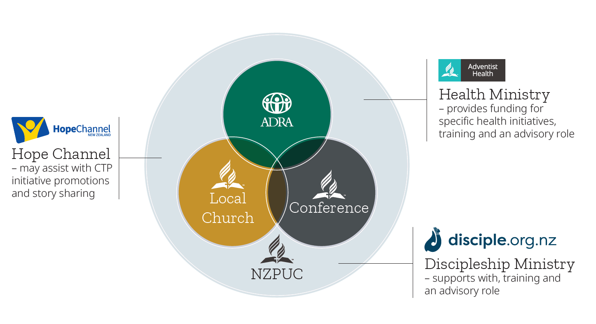
Partnership Model
Funding model – 1/3 Local Church, 1/3 Conference, 1/3 ADRA

Slide 5



Churches
CTP
Centre’s of Influence
Discipleship Path Model
Notes:
North New Zealand Healthy Communities as an example of strategies. Change this according to emphasis of the territory.

Slide 6



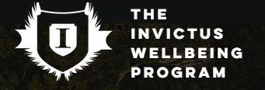

Community Transformation Partnerships

Slide 7


Community Transformation Partnerships
> My Family
  Pre-designed and resourced
  Shorter-term projects
  From $3,000
> Innovations
  Locally designed
  Longer-term programmes
  Min $5,000 up to $15,000

Slide 8
How do I start a CTP Initiative?
Notes:
What is CTP?
- Who knows what CTP stands for? Community Transformation Partnerships

Slide 9
Process
Pray & Organise Team
    At least 3 people
    What are the needs of your community?
Research & Design/Select Programme
Complete Application Form
Submit Application

Slide 10
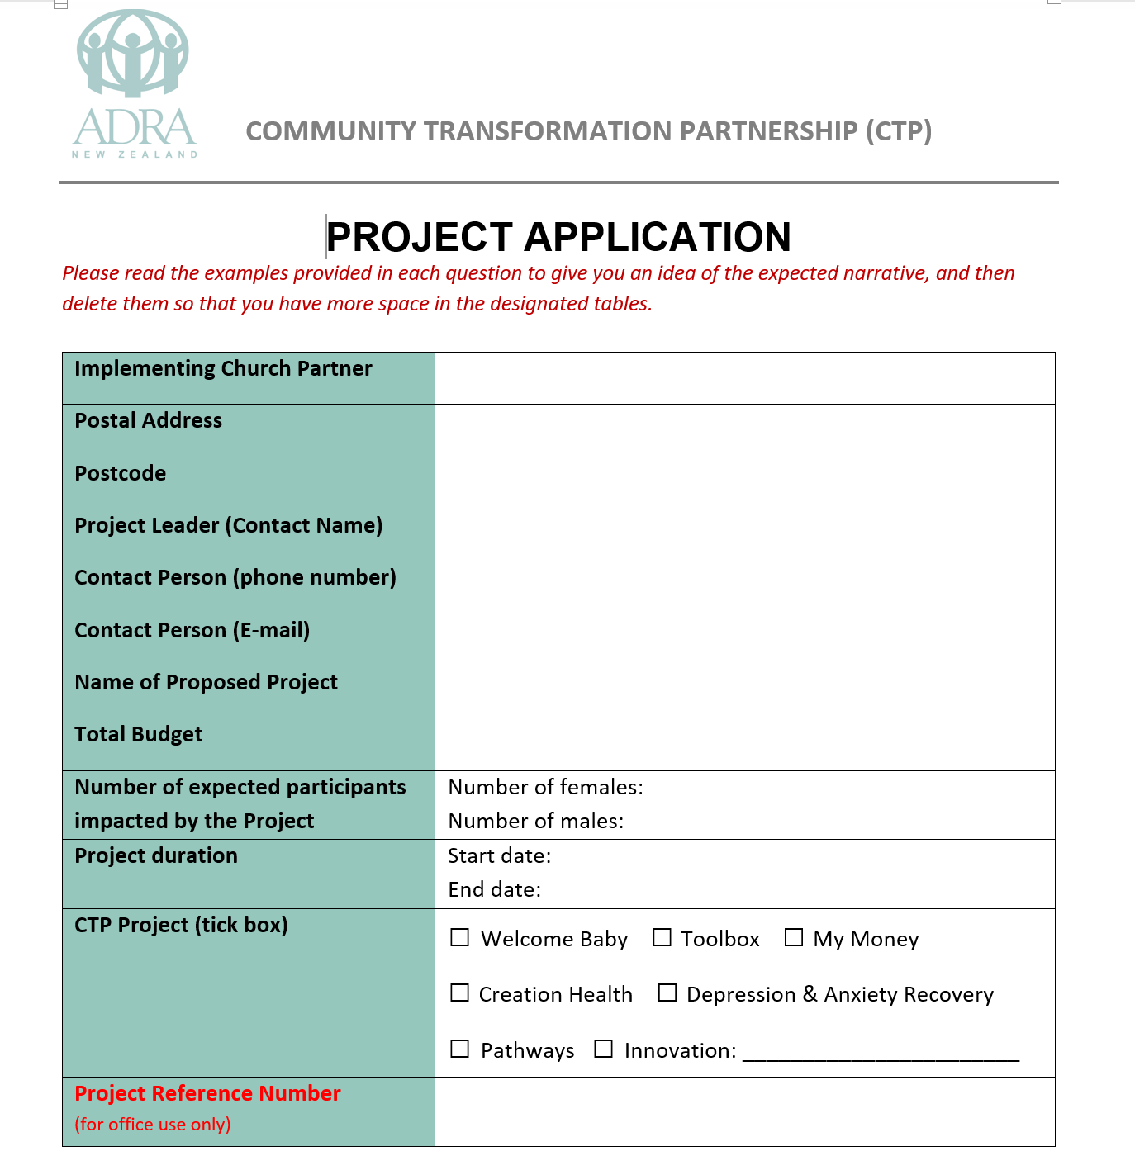
CTP Application Form
Notes:
First page is basically just your contact details and noting the overall details of the project you want to apply for funding for.
If it’s an innovations project, then you just need to tick the innovations box and type in the project name.

Slide 11
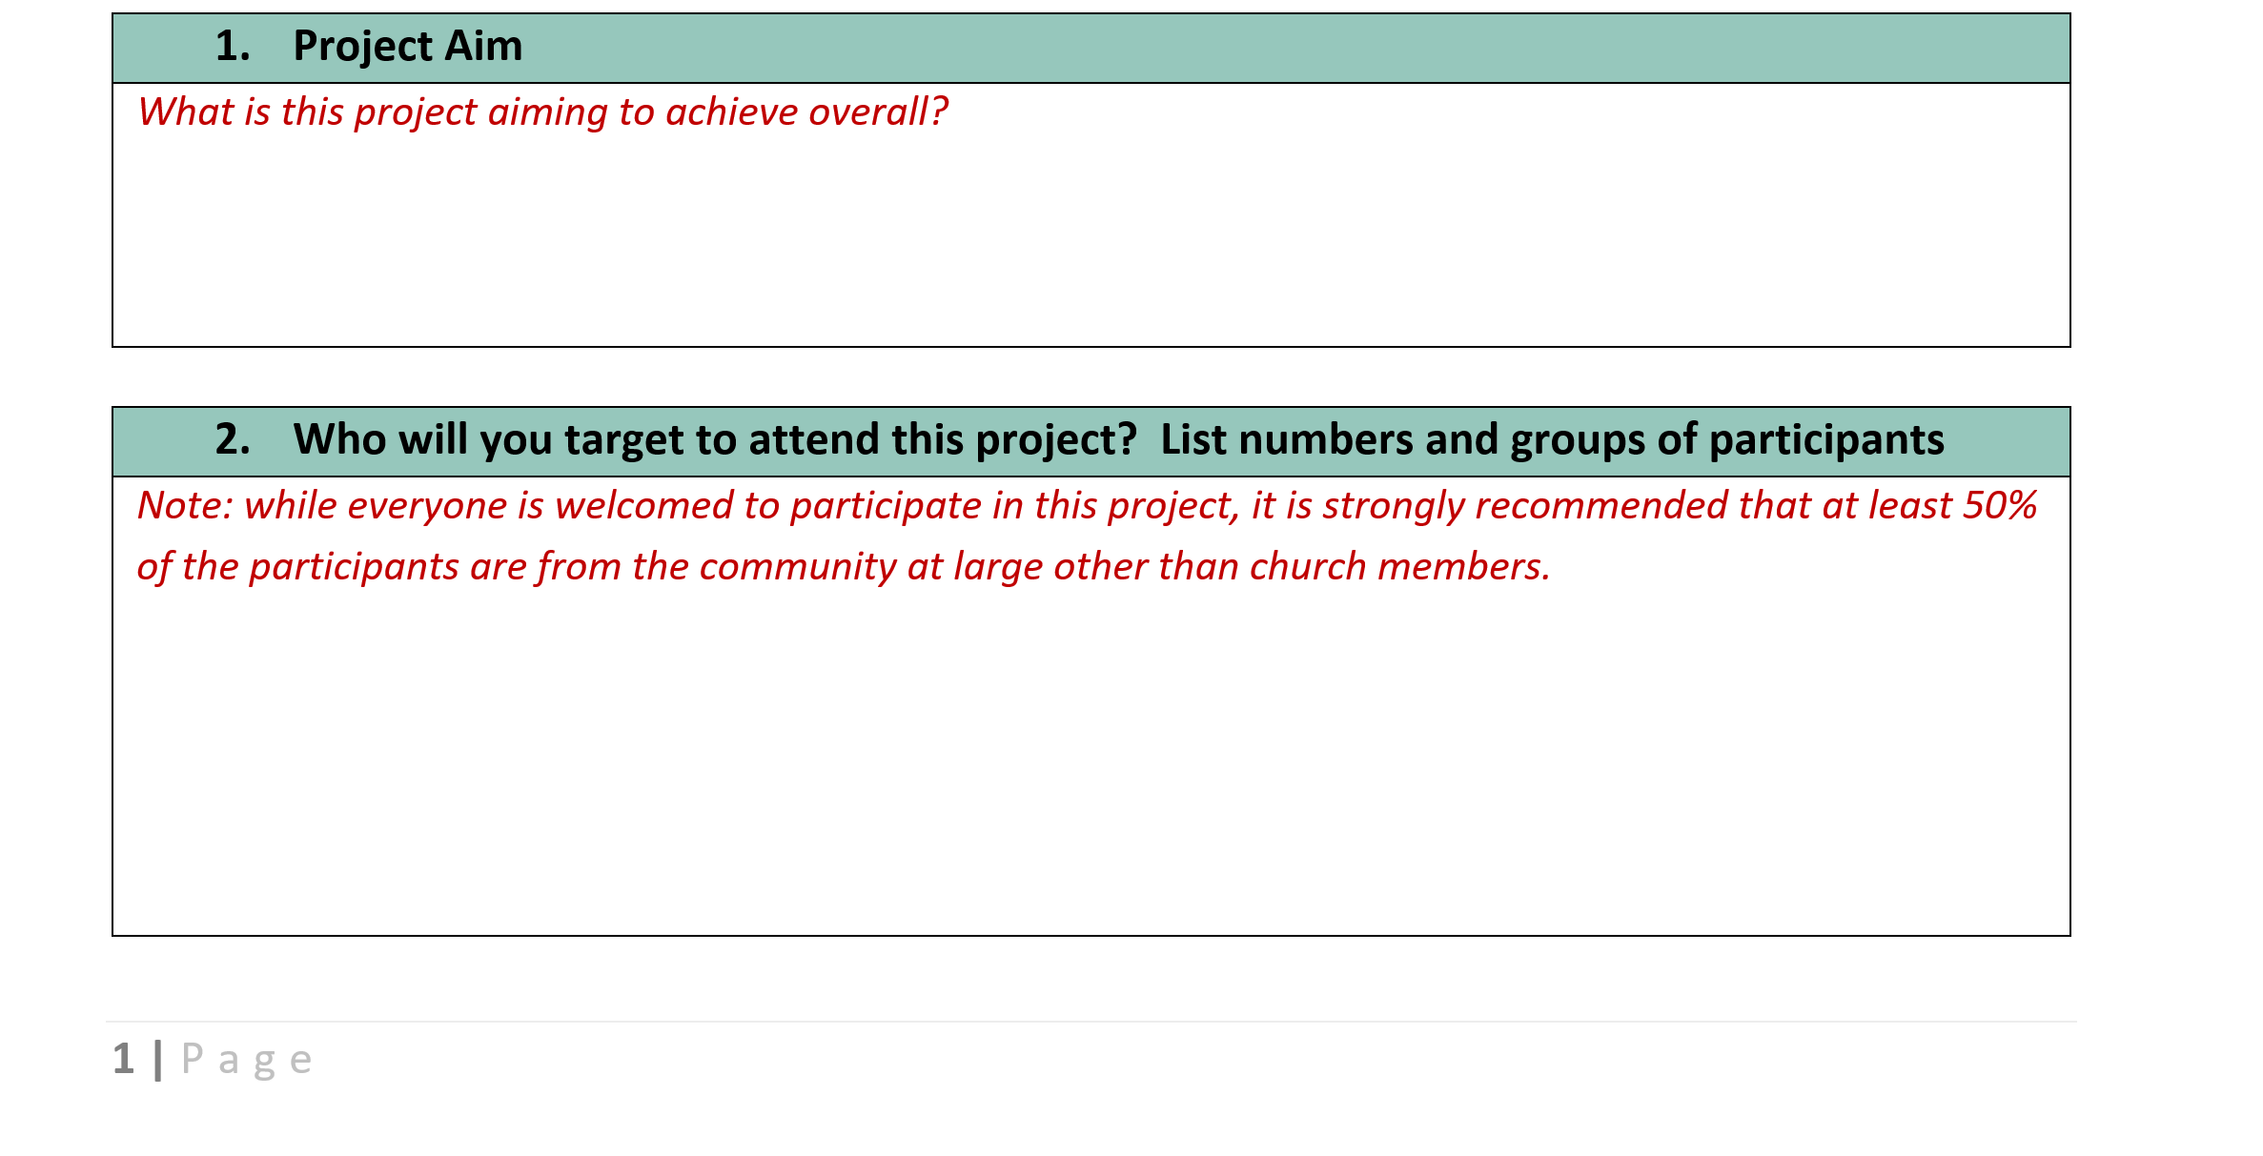
Notes:
Red text in each field is to help provide some guidance around the type of information that should be included in each field.

Slide 12
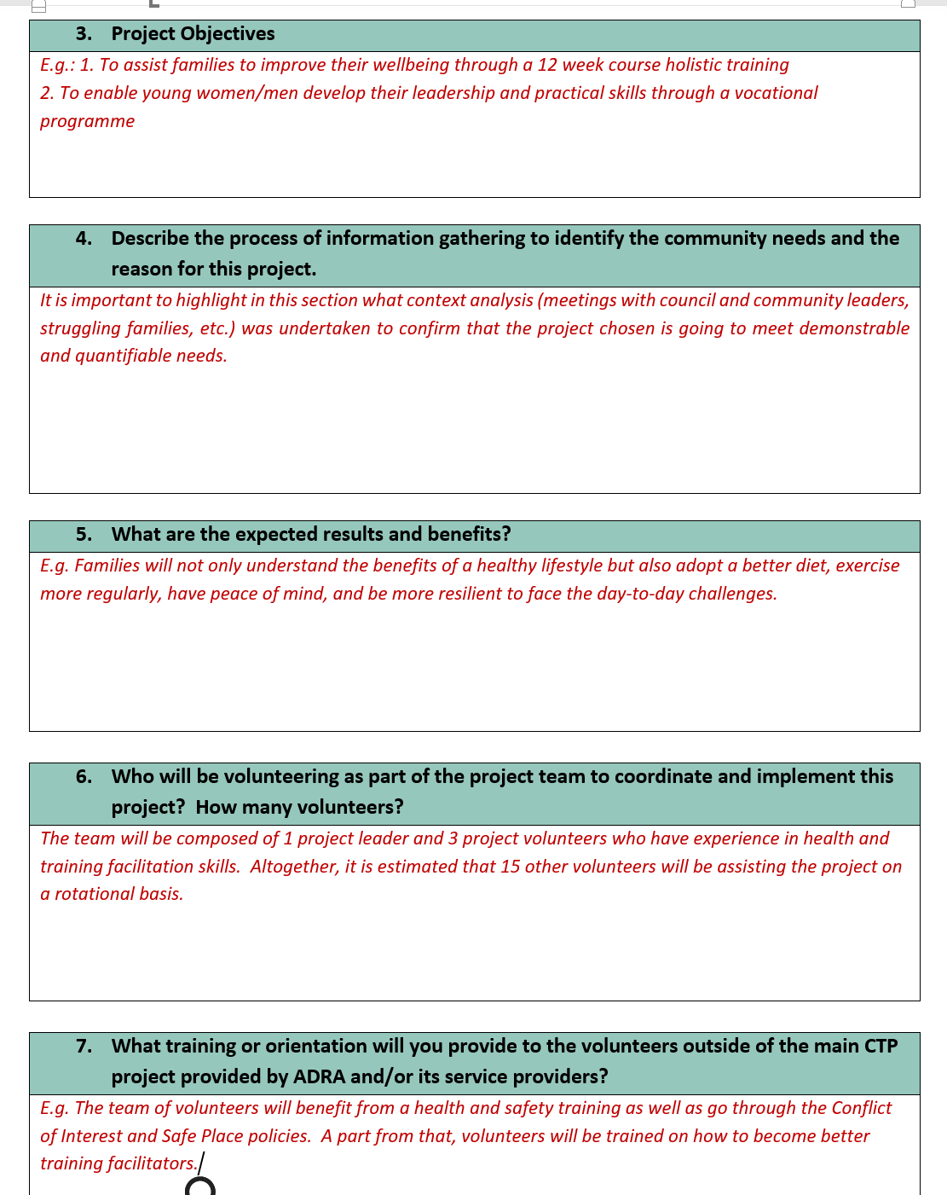
Notes:
3. Project objectives – should be all the activities that make up your programme.
4. Process of gathering information – this is where Community Assessment and needs analysis are important to help give some backing to why you are running this programme/initiative.
7. Training or orientation – for every project Adsafe certification and police vetting is a must especially for those in the project who will be dealing directly with the community or young people/children.

Slide 13
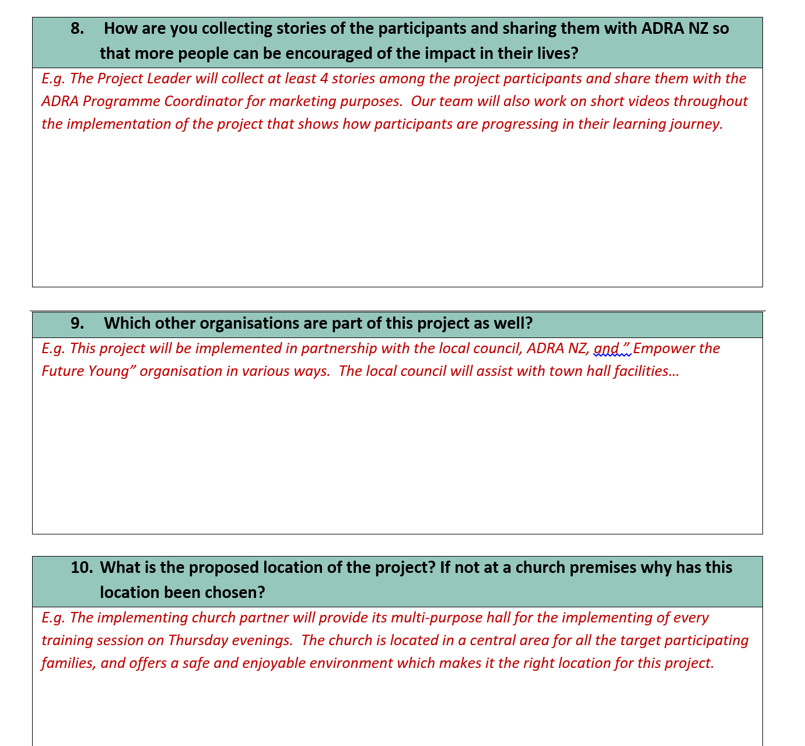
Notes:
8. Collecting stories and data collection should be part of your project design, not something you think about after the fact.

Slide 14
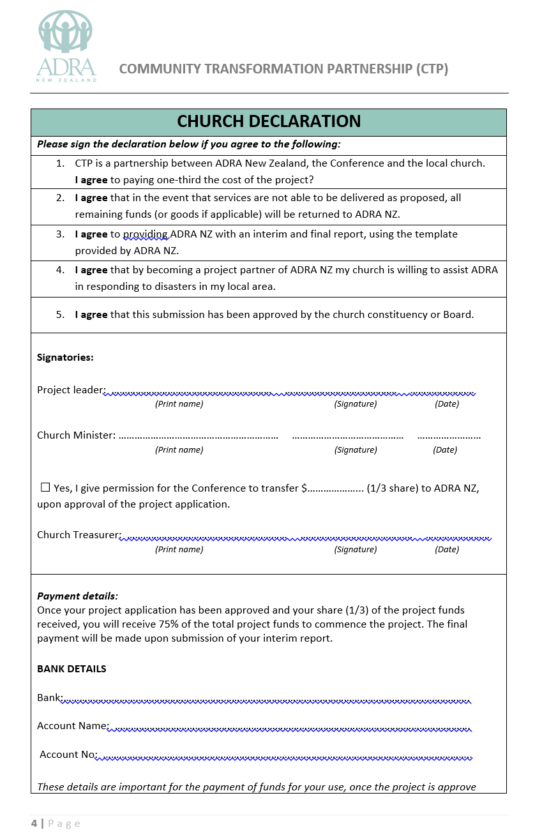
Notes:
Church Declaration Form – important that this is one page of it’s own, not split over two pages.

Slide 15
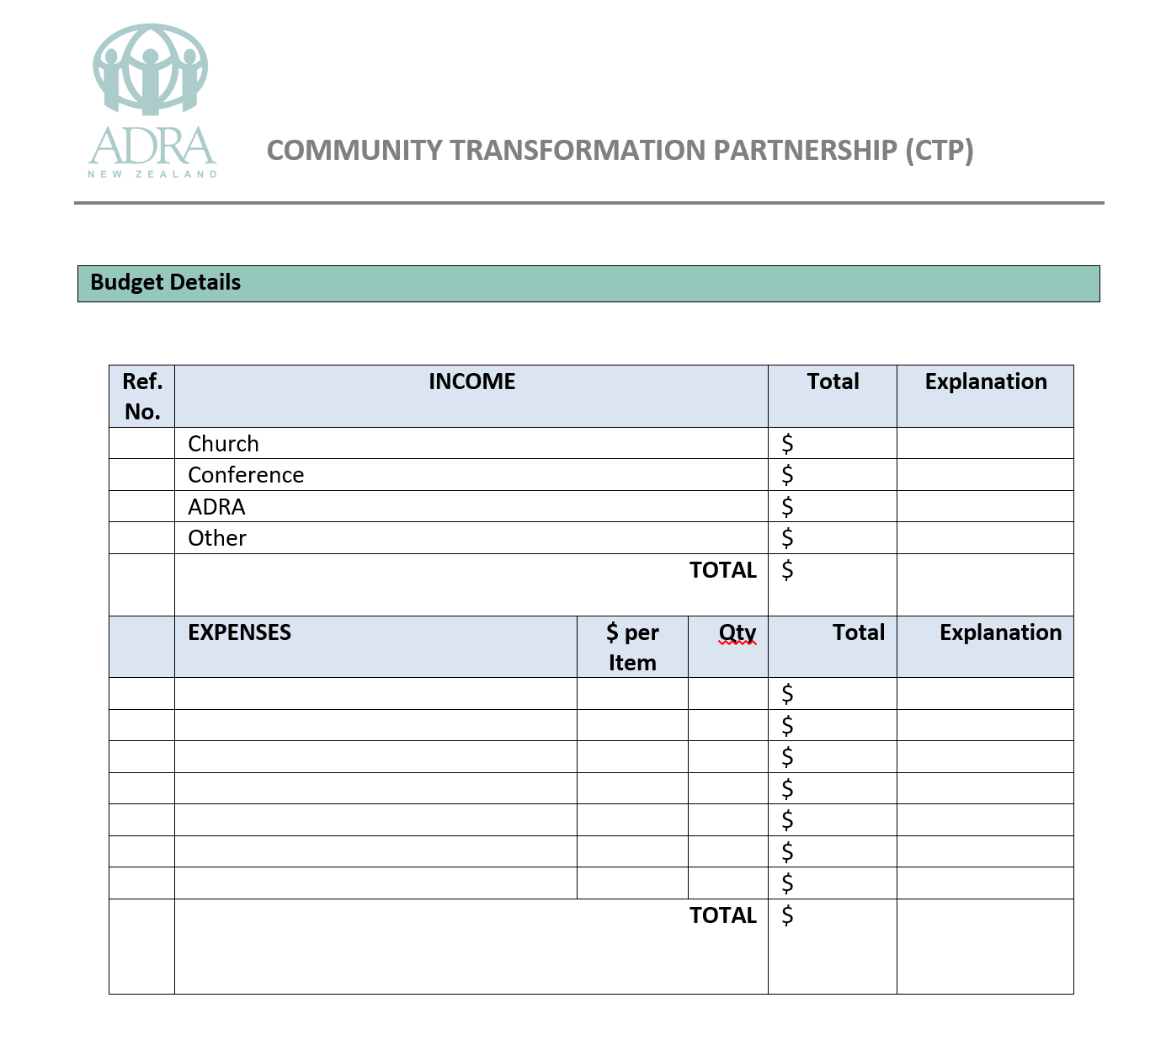
Notes:
Budget:
Line items should match the various activities/expenses you are sharing in your application.
If not, more likely that the Committee reviewing the application will question why.

Slide 16
FUNDING GUIDELINES AND CRITERIA
Sport and recreation, other than an engagement activity as part of a youth mentoring project.
Core education, including scloarships, regular education equipment and activities; buildings or land.
Capital assets or equipment costing over $3,000; Advertising, promotion and/or administration costs which exceed 20% of the total cost of the initiative.
Drama art or performing arts as a “Stand Alone” programme are excluded but if there is a module of drama/arts/sports activity within the programme and as long as this activity is not deemed to be the sole focus of the programme it may be included for funding consideration.
Individuals; loans and endowment funds.
Overseas travel, exchange programmes or projects outside the geographic borders of New Zealand.
Religious or political advocacy or advancement.
Venture Captial initiatives.
Urgent or retrospective applications.
Funding to any one project for more than 3 years.
Notes:
Important to note funding guidelines and criteria, so you know what you can and can’t be funded for.

Slide 17
Funding Rounds
Round 1
Submission of proposals deadline- 15 March
Round 2
Submission of proposals deadline – Extended to 15 June
Round 3
Submission of proposals deadline – 15 August
Round 4 (dependent on funding availability)
Submission of proposals deadline – 15 October
Notes:
We have four funding rounds a year.

Slide 18
Reporting Requirements
Every project requires reporting
Short term projects –final completion report only
Long term projects – interim and final report
Notes:
We need to be good stewards of the resources God places us in charge of. Hence the importance of reporting, but also why planning for how you are going to report your budget needs to take place when designing and organizing your project.
Reporting also provides the platform for you to share your stories, and how the initiative is making a difference in the lives of those around you.

Slide 19
Questions

Slide 20

Notes:
Complete the next steps form

Slide 21
Wrap up
&
Closing Prayer

