Slide 1


CHAMPION’S QUIZ & CHALLENGES
Do you have what it takes to be a champion?

Slide 2
Get into groups of 8!
The more diverse your group, the more diverse knowledge you have to help you.

Slide 3
Music Round
Songs about Champions, community, and service

Slide 4
New Zealand Geography Round
Do you know your community?

Slide 5
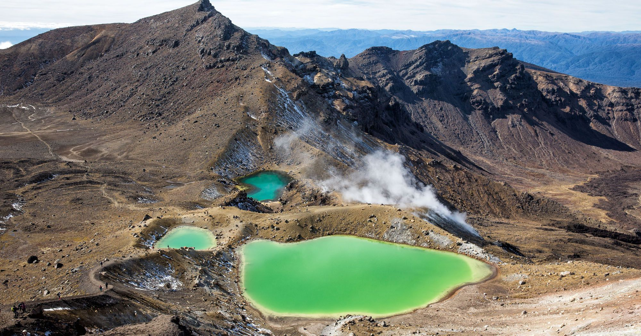
Identify the Location
Question 1

Slide 6
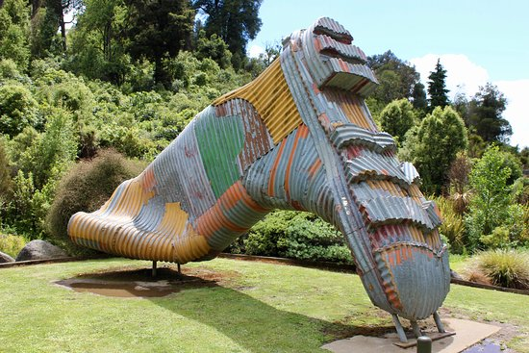
Identify the Location
Question 2

Slide 7
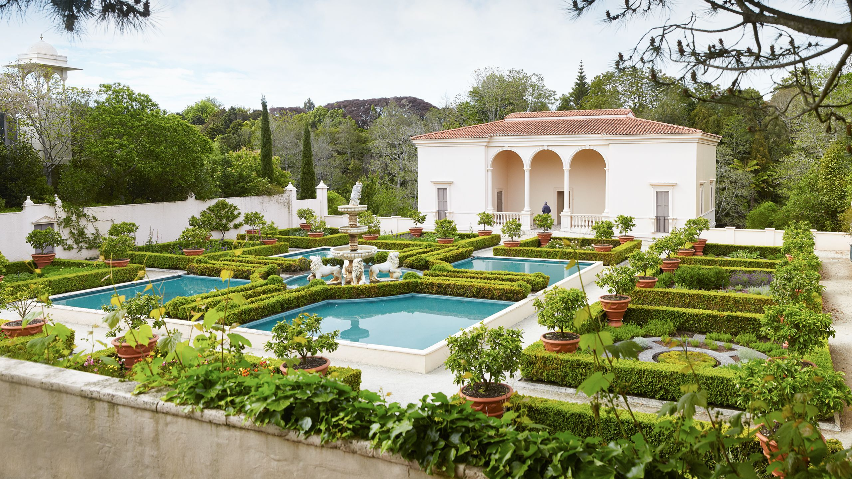
Identify the Location
Question 3

Slide 8
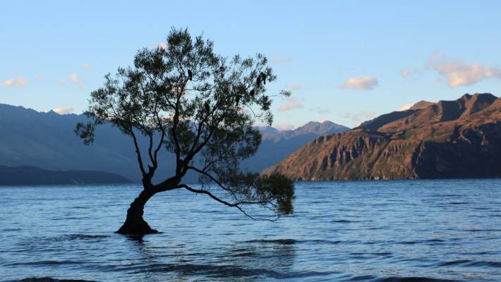
Identify the Location
Question 4

Slide 9
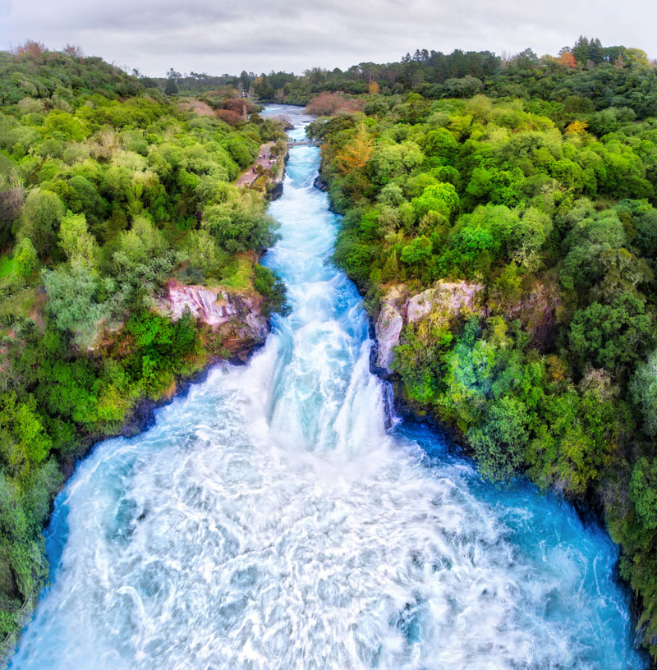
Identify the Location
Question 5

Slide 10
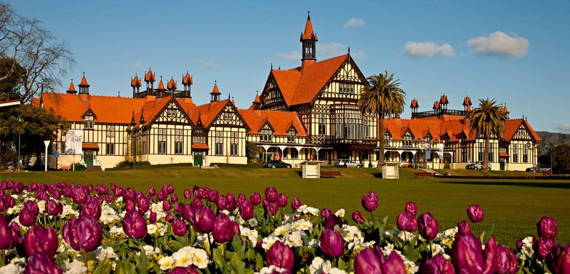
Identify the Location
Question 6

Slide 11
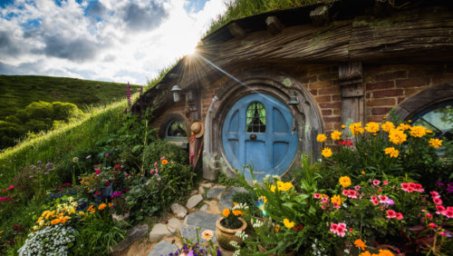
Identify the Location
Question 7

Slide 12
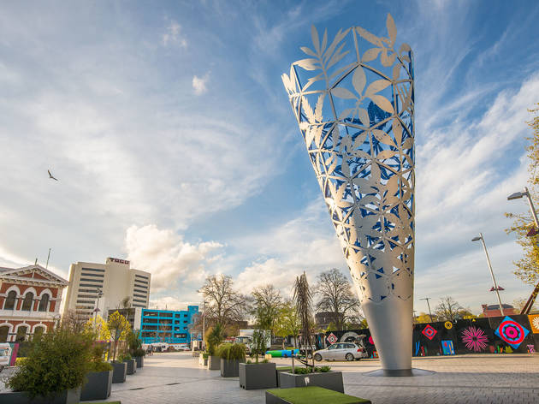
Identify the Location
Question 8

Slide 13

Identify the Location
Question 9

Slide 14
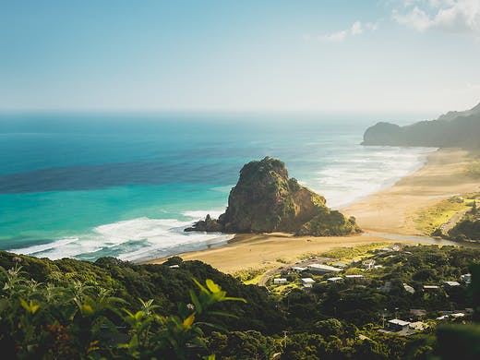
Identify the Location
Question 10

Slide 15
Challenge
Create the Tallest or largest structure with playing cards

Slide 16
Famous Champions of Change
Can you identifty who they are?

Slide 17
Which Champion said:
“I have a dream, that one day this nation will rise up and live out the true meaning of it’s creed – we hold these truths to be self-evident: that all men are created equal.”

Slide 18
Which Champion said:
“Be the change you wish to see in the world.”

Slide 19
Which Champion said:
“Float like a butterfly, sting like a bee.”

Slide 20
Which Champion said:
“Imagination is more important than knowledge.”

Slide 21
Which Champion said:
“We make a living by what we get, but we make life by what we give.”

Slide 22
Which Champion said:
“Not all of us can do great things. But we can do small things with great love.”

Slide 23
Which Champion said:
“That’s one small step for man, one giant leap for mankind.”

Slide 24
Which Champion said:
“How wonderful it is that nobody need wait a single moment before starting to improve the world.”

Slide 25
Which Champion said:
“To be or not to be, that is the question.”

Slide 26
Which Champion said:
“Blessed are the poor in spirit, for theirs is the kingdom of Heaven.”

Slide 27
Challenge
Find the following items within your team

Slide 28
Challenge
Find the following items within your team

Slide 29
Bible Champions
Name the bible champion!

Slide 30
Who am I?
Because of my faith and my ability to hide the spies, my home was not destroyed.

Slide 31
Who am I?
I lived in a big fish for three days.

Slide 32
Who am I?
I was the cousin of Esther who raised her like a daughter.

Slide 33
Who am I?
I was the wife of Zechariah and the mother of John.

Slide 34
Who am I?
I was a prophetess who led Israel.

Slide 35
Who am I?
I did good deeds and charity in the town of Joppa.

Slide 36
Who am I?
I wrote a letter to the seven churches while I was on the island of Patmos.

Slide 37
Who am I?
I was taken to heaven in a windstorm.

Slide 38
Who am I?
I became Queen of Persia in place of Vashti.

Slide 39
Who am I?
I built the first temple.

Slide 40
Challenge
Create your best kiwi icon

Slide 41
Health
Were you paying attention?

Slide 42
1. What does ELIA stand for?

Slide 43
2. List the 7 dimensions of wellness

Slide 44
3. What does CHIP stand for?

Slide 45
4. What lifestyle diseases can CHIP positively impact?

Slide 46
5. When talking about peak flow, what body function are we talking about?

Slide 47
6. List 3 benefits of exercise

Slide 48
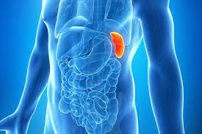
7. Identify this body part

Slide 49
8. What’s the anatomical name for your funny bone?

Slide 50
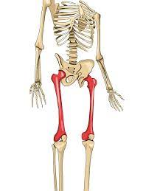
9. Identify this body part

Slide 51
10. Where on your body can you find your hammer and anvil?

Slide 52
Challenge
Use your team to spell out “CHAMPION”

Slide 53
Discipleship
Were you paying attention?

Slide 54
1. What does SHAPE stand for?

Slide 55
2. Who were the first 2 disciples to follow Jesus?

Slide 56
3. Where do you find the Great Comission?

Slide 57
4. What are the 3 Be’s of Discipleship

Slide 58
5. Finish this verse:
People will know you are my disciples if you__________

Slide 59
6. Judas was replaced by which disciple?

Slide 60
7. Which story do you find in Acts 29?

Slide 61
8. Finish this verse:
I am the vine ___________

Slide 62
9. Fill in the blank
Whoever wants to be my disciple must deny themselves, and take up their _____ and follow me

Slide 63
10. What did Jesus want his disciples to fish for?

Slide 64
Challenge
Do an acrostic CHAMPION puzzle

Slide 65
ADRA
Were you paying attention?

Slide 66
1. What does SHAPE stand for?

Slide 67
2. What does ‘D’ stand for in ‘ADRA’?

Slide 68
3. Name 2 partners of ADRA

Slide 69
4. Complete this saying:
Aroha Mai (Love Received)
__________ (_________)

Slide 70
5. What % of kiwi’s identify as Christian?

Slide 71
6. Name a CTP project

Slide 72
7. Name one international disaster ADRA has responded to

Slide 73
8. What was the name of ADRA’s COVID-19 response in NZ?

Slide 74
9. Name one major funder of ADRA

Slide 75
10. Name 5 ADRA staff or board members

Slide 76
CHAMPION’S QUIZ & CHALLENGES
And the winner is...

