Slide 1
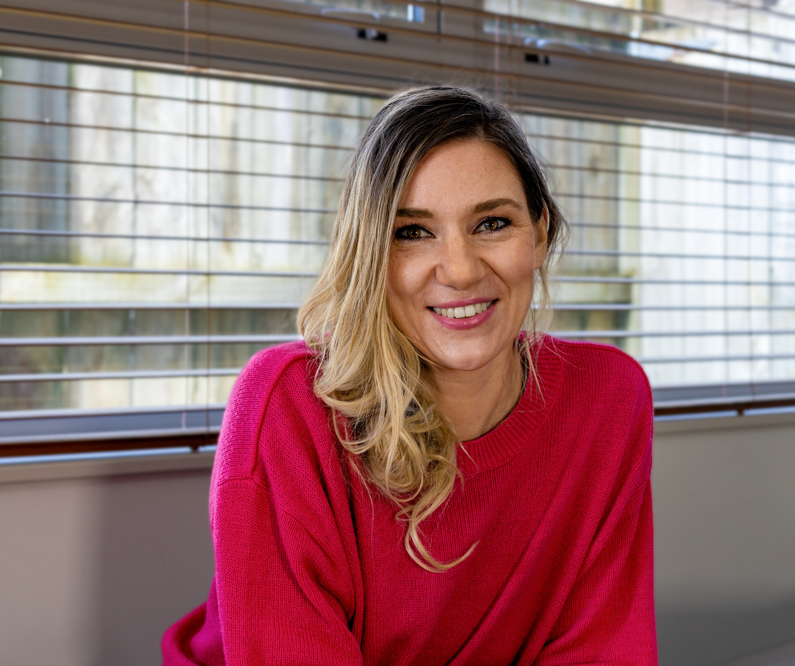




Give Today
Let Love Shine in your community!
This year we've helped 2,800 kiwi families. Your offering today will ensure we can continue to serve here in New Zealand and around the world.
Please give through your offering or online:
adra.org.nz/shine

