Slide 1

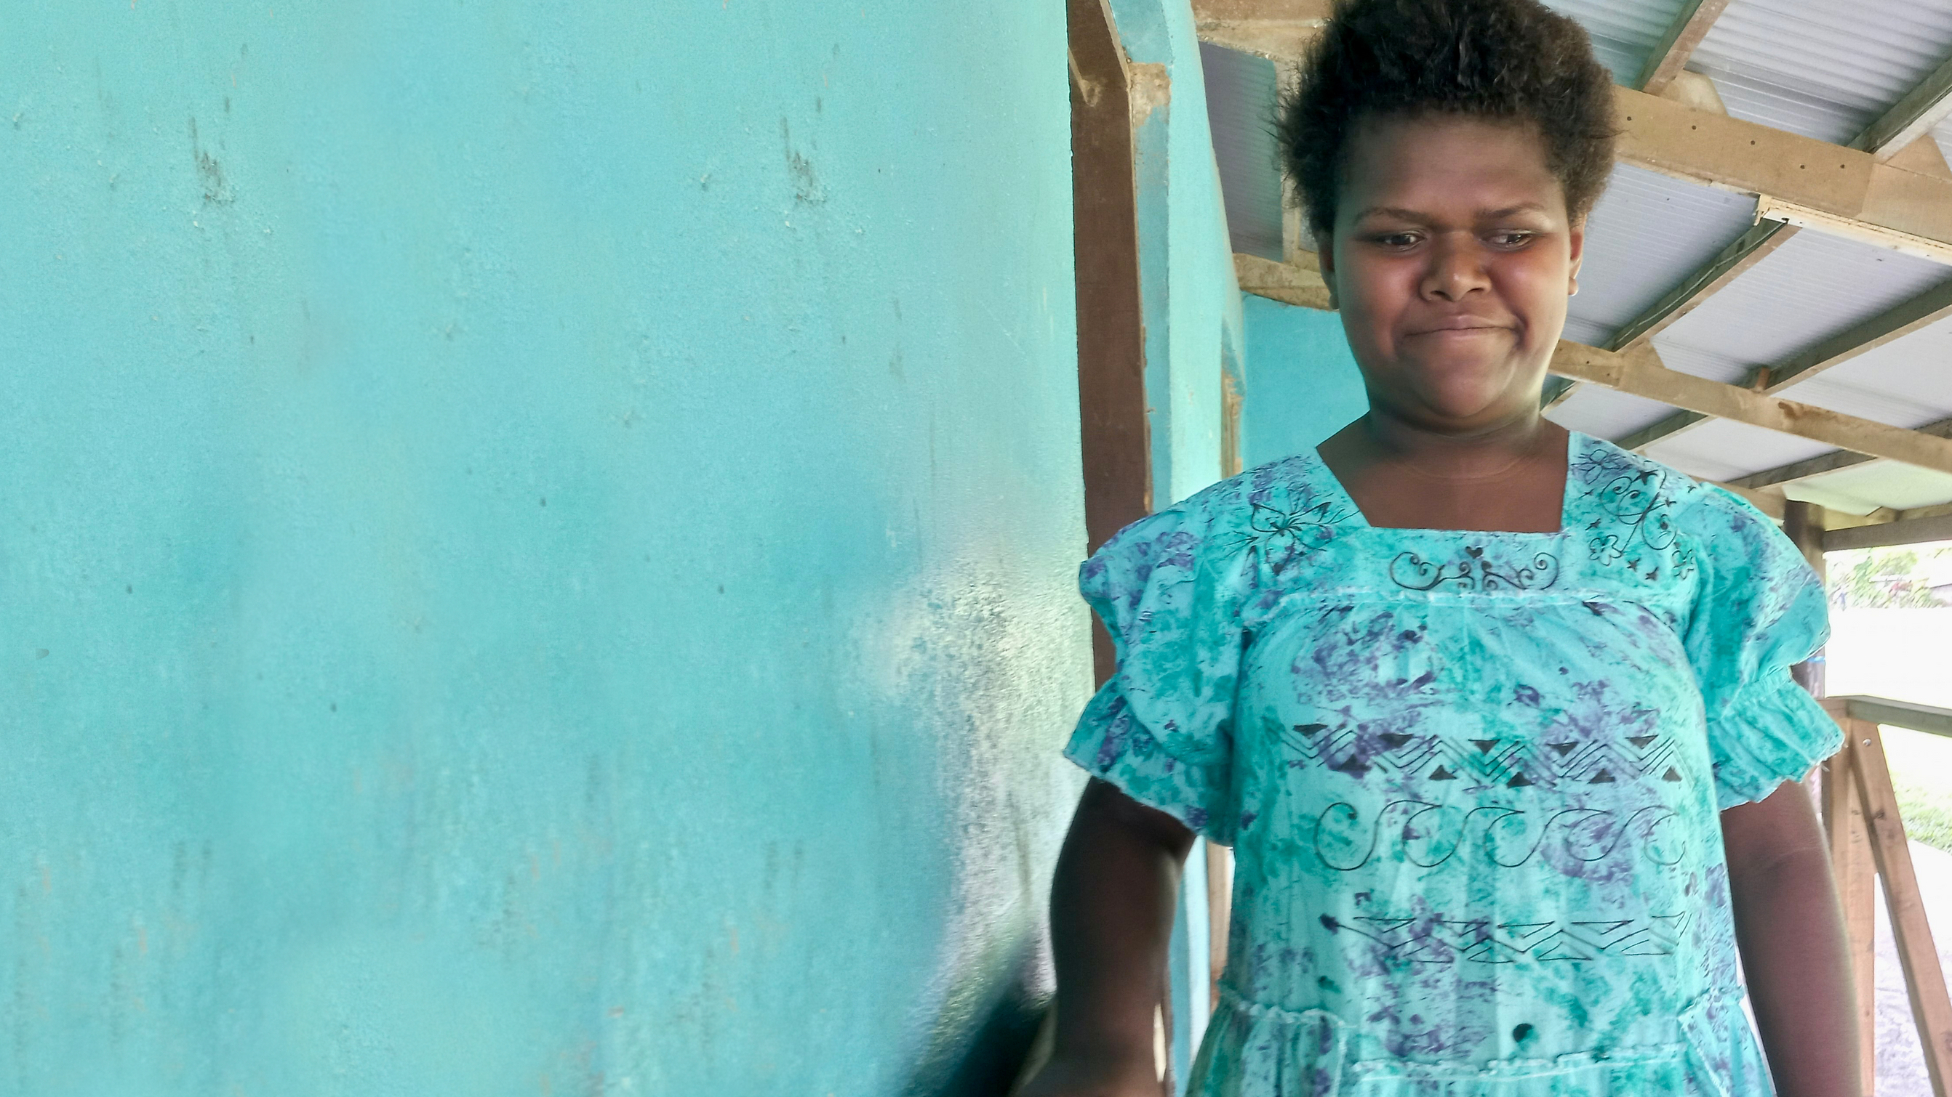

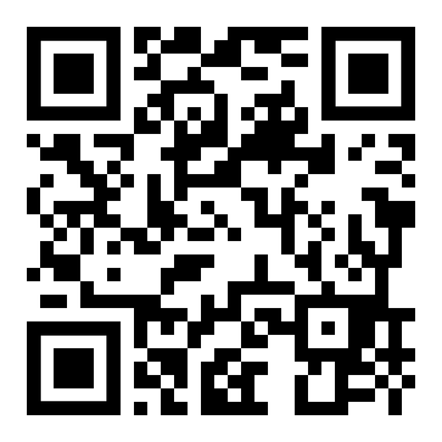
Appeal offering
Help girls like Hana by providing essential facilities and social support to improve wellbeing and build belonging for those most in need.
Scan to
Give
Hana (14), in Vanuatu lives with a disability and doesn't have access to health facilities.
adra.org.nz/belong

