Slide 1


Whanaungatanga
Interconnected Relationships

Slide 2
Introduction:
Our starting place is what we share…
As a group, discover as many things as possible that you all have in common or share a link to.

Slide 3
“Whītiki te tangata,
Mārama te kitea.”
The tighter the bond, the brighter the light.
Notes:
https://etuwhanau.org.nz/wp-content/uploads/2022/12/ETW_Whanaungatanga_Web.pdf

Slide 4
What is WHANAUNGATANGA?

Slide 5
“At the heart of Te Ao Māori lies the principle of whanaungatanga, emphasizing the importance of building and maintaining meaningful relationships. This mirrors the core tenet of collectivism, which values the interconnectedness of individuals within a community. Whanaungatanga encourages collaboration, mutual support, and a sense of belonging, reinforcing the idea that the strength of a community lies in the bonds between its members.”

Slide 6
“Relationship, kinship, sense of family connection - a relationship through shared experiences and working together which provides people with a sense of belonging. It develops as a result of kinship rights and obligations, which also serve to strengthen each member of the kin group. It also extends to others to whom one develops a close familial, friendship or reciprocal relationship.”

Slide 7
“Whanaungatanga encompasses the idea of building and nurturing relationships based on kinship and a sense of belonging…
Whanaungatanga highlights the importance of unity, cooperation, and mutual support within a community or whānau (extended family) context. It emphasises the value of establishing positive relationships, respecting others, and working together towards common goals.”

Slide 8
“Kinship-type relationships can be developed with whānau, friends, colleagues, community or any rōpū with shared purpose in which connections are formed and fostered. Whanaungatanga supports positive relationships and connections.”

Slide 9
“Whanaungatanga creates cohesion, a sense of unity, and a sense of togetherness amongst the people. Whanaungatanga can be expressed through the relationships that are developed between families and their communities. The stronger and more cohesive these relationships, the more vibrant and enriching communities are.”

Slide 10
Questions:
What do relationships currently look like in/between our churches and communities?
How is this the same/different from the concept of whanaungatanga?

Slide 11
MARAE
(verb) to be generous, hospitable.
(noun) courtyard - the open area in front of the wharenui, where formal greetings and discussions take place. Often also used to include the complex of buildings around the marae.

Slide 12

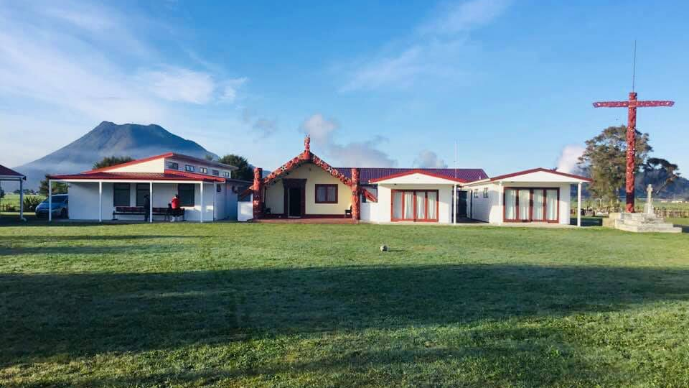
Hahuru Marae - Onepu

Slide 13
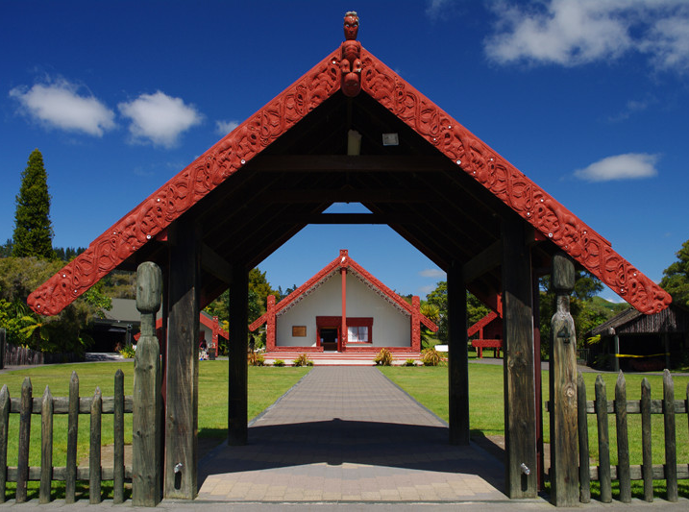

Pōwhiri
Karanga – to call
Wero – Challenge
Whaikōrero – Formal speech
Waiata – Song, to sing
Harirū, Hongi – shaking of hands, touching of noses
Hākari – Feast
Mihimihi – Introductory speeches, greeting
Poroporoaki – formal farewell (graduation)
This Photo by Unknown Author is licensed under CC BY
Notes:
Karanga - Call

Slide 14
Questions:
What various responsibilities and relationships have you witnessed on the marae today?
What values are evident through the powhiri process?
From the previous definitions, what aspects of whanaungatanga did you see?

Slide 15
Why does this concept matter today?
Where do we see whanaungatanga in Scripture?

Slide 16
Obstacles & Opportunities
How can building whanaungatanga be challenging?
What realities does it involve?
Where does the responsibility lie?

Slide 17
Obstacles & Opportunities
What are the small/big changes that need to take place for whanaungatanga to be enriched…
  In/with our churches?
  In/with our communities?
Who/what do we need to include in the process?
Describe a church/community where whanaungatanga is a lived reality?

Slide 18
BIG QUESTIONS:
Where does whanaungatanga start?
What is your next step?

Slide 19
“Whītiki te tangata,
Mārama te kitea.”
The tighter the bond, the brighter the light
Notes:
https://etuwhanau.org.nz/wp-content/uploads/2022/12/ETW_Whanaungatanga_Web.pdf

